Slide 1
Grasshopper Beam Engine
Prepared By:
Supervised By:
Course::
Date:

Slide 2
Introduction
Steam engines have been developed over the years to help convert thermal energy to kinetic energy.
First grasshopper beam engine was developed by William Murdoch in 1784.
The beam in a grasshopper beam engine is 1 ¾ times longer than the total stroke length.
Beam is guided in a straight line by a parallel movement device.
The model is rigid, compact, and simple.

Slide 3
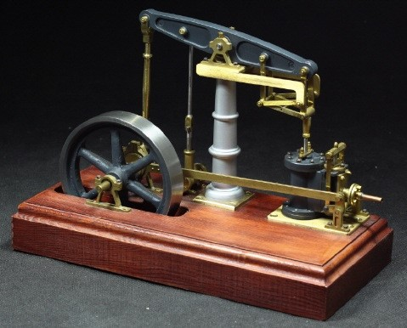
Introduction cont’
Steam beam engine generally made from a rectangular frame fused with a lattice or crossed struts.
  Figure 1: Steam beam engine (Frenken, 2004).

Slide 4
Components’ Design
The grasshopper beam engine is made of several components.
These include the base, the crankshaft, the beam, crosshead, the moving leg, cylinder and piston, and the flywheel.
Each of these materials is made of a different material, which determines its stability and the ability to function optimally.

Slide 5
Material Selection
Most widely used steel is mild steel because it is cheaper, weldable, very hard, and durable.
Stainless steel, on the other hand, has a high chromium content making it resistant to corrosion, strong, durable, resistant to temperature changes, easy to fabricate, and form.

Slide 6
Manufacturing Procedure
Casting – easy, simple, and cheap. It is based on converting metal to a liquid by raising its temperature and pouring the liquid into a mold, where it is shaped.
Milling machine used to shape metal parts. Also, used to remove excess metal parts.
Drilling process – used to make holes in metal pieces. Requires high pressure.

Slide 7
Kinematic Analysis
There are different displacements, velocities, and accelerations of the arms.
Displacement – two critical positions. First critical position; DE is above O4; second critical position, DE is below O4. Links of displacement are OA, OC, OD, DE, and FF’.
Velocity – V=ωR=1*213=213 cm/s
Links of velocity are – OC, DC, OD, CB, BA, OA, and OE.
Acceleration - a_n=V^2/R.
Links of acceleration are OC, DC, OD, CB, BA, OA, and OE.

Slide 8
Kinetic Analysis
The kinetic energy changes from one link to another.
It increases from link 1 to link 4 and remains constant up to link 6.
In link 1, the kinetic force is 150 KN, 705 KN for link 2, 721 KN for link 3, 721 KN for link 4, 721 KN for link 5, and 721 KN for link 6.

Slide 9
Conclusion
Grasshopper beam engine plays a critical role in portraying how energy is converted from one form to another.
It is made of different components, including the base, the crankshaft, the beam, crosshead, the moving leg, cylinder and piston, and the flywheel.
Materials used can be mild steel and stainless steel.
There are three main manufacturing procedures, including casting, milling, and drilling.

Slide 10
References
Frenken, K. (2004). The early development of the steam engine: an evolutionary interpretation using complexity theory. Industrial And Corporate Change, 13(2), 419-450. doi: 10.1093/icc/dth017
Thurston, R. (1899). THEORY OF THE STEAM ENGINE. Science, 9(227), 659-659. doi: 10.1126/science.9.227.659
A model single cylinder Grasshopper beam engine,. (2018). Retrieved 23 April 2021, from https://www.christies.com/en/lot/lot-769604
Polly Model Engineering: Stationary Engine Kits - Anthony Mount Models. (2021). Retrieved 23 April 2021, from https://www.pollymodelengineering.co.uk/sections/stationary-engines/anthony-mount-models/easton-Andersons-Grasshopper-Beam-Engine.asp

